Slide 1
GAMMs for LVC
Caitlin Halfacre
Manchester Metropolitan University

Slide 2
Generalised Additive Mixed Model
Notes:
Dynamic = over time – can be short (formant trajectory) or long (lifespan) or in between (pitch track)

Slide 3
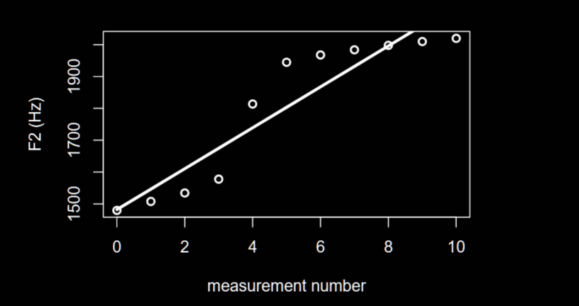
Linear regression
model <- lm(F2 ~ measurement.no, data)

Slide 4
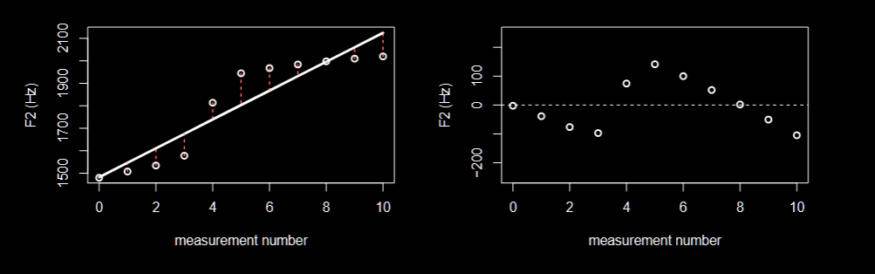
Linear regression
model <- lm(F2 ~ measurement.no, data)

Slide 5
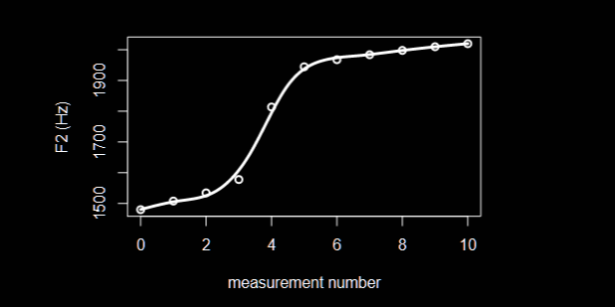
Generalised Additive Mixed Model
model <- bam(F2 ~ s(measurement.no, bs = “cr”), data)

Slide 6
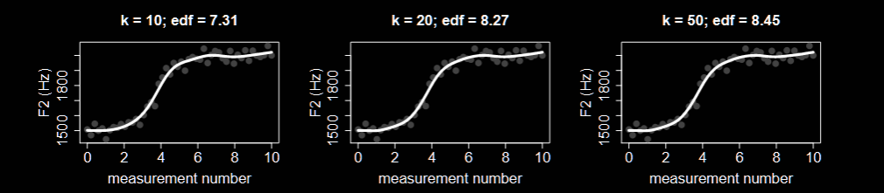
Generalised Additive Mixed Model
model <- bam(F2 ~ s(measurement.no, bs = “cr”, k = 10), data)
model <- bam(F2 ~ s(measurement.no, bs = “cr”, k = 20), data)
model <- bam(F2 ~ s(measurement.no, bs = “cr”, k = 50), data)
Notes:
• too few measurements to support k knots: If our trajectories only have 11 measurements, the maximum number of knots is also 11 (that is, the maximum number of basis functions is 10). Since the default value for k is 10 (although this number may be different depending on the type of smooth), it needs to be lowered if there are less than 10 unique values for a given variable. • not enough wiggliness allowed: The default value of k can only support a certain amount of wiggliness in the data. If the actual trajectories show a greater degree of non-linearity, k needs to be increased. • computational inefficiency due to high k: The higher the value of k, the longer it will take to fit the model. Therefore, it is a good idea not to increase k any further than necessary. In realistic scenarios, the modeller may be forced to choose a k that is actually lower than would be ideal.

Slide 7
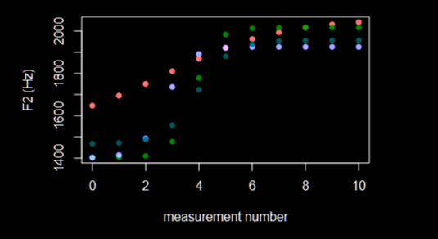
Generalised Additive Mixed Model

Slide 8
Generalised Additive Mixed Model

Slide 9
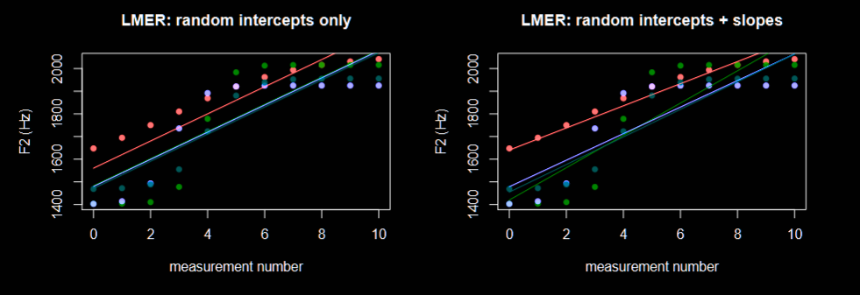
Generalised Additive Mixed Model

Slide 10
Generalised Additive Mixed Model

Slide 11
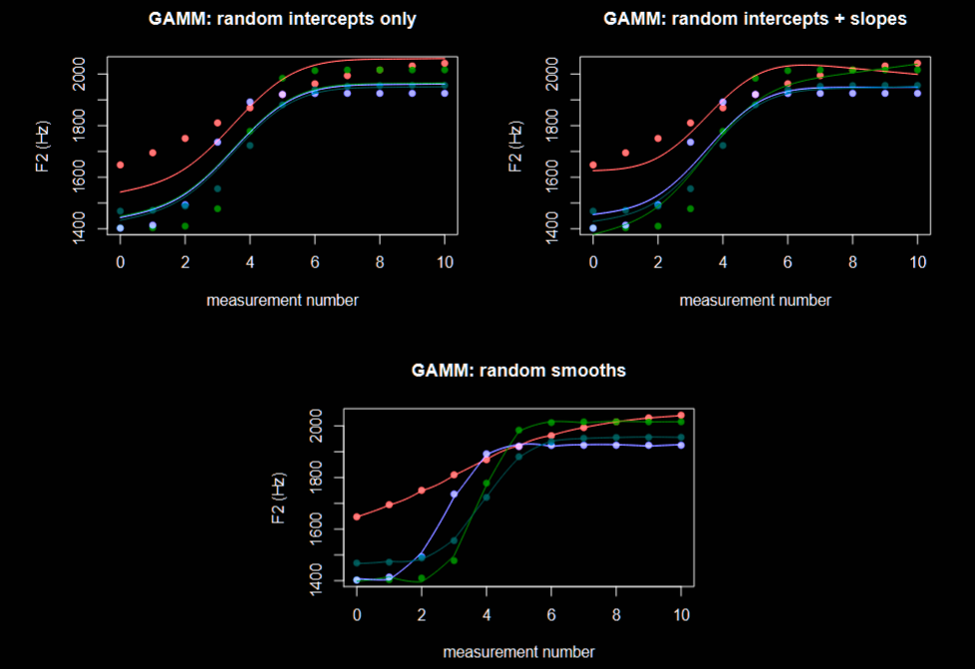
Notes:
The model with random intercepts simply varies the height of the lines, but does not yield a particularly good fit. The one with slopes does slightly better: in this case, the same curve is essentially rotated and stretched to match the actual trajectories. Random smooths clearly provide the best fit by fitting individual curves to each trajectory. Note, however, that random smooths are also extremely resource intensive: fitting four separate random smooths to the data requires 4 × k basis functions, and the same number of coefficients need to be estimated.5

Slide 13
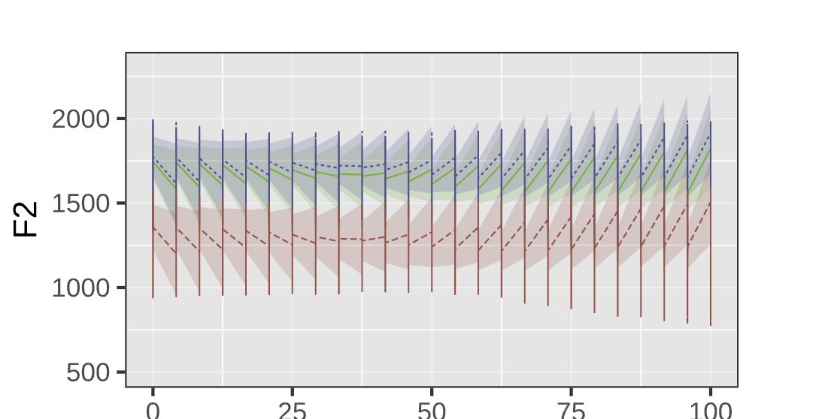
When model plotting goes awry…a thread
#accidental_aRt

Slide 14
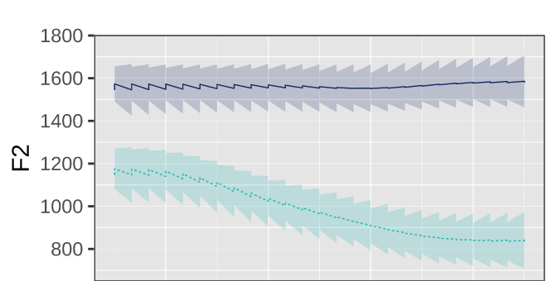
When model plotting goes awry…a thread
#accidental_aRt

Slide 15

When model plotting goes awry…a thread
#accidental_aRt

Slide 16
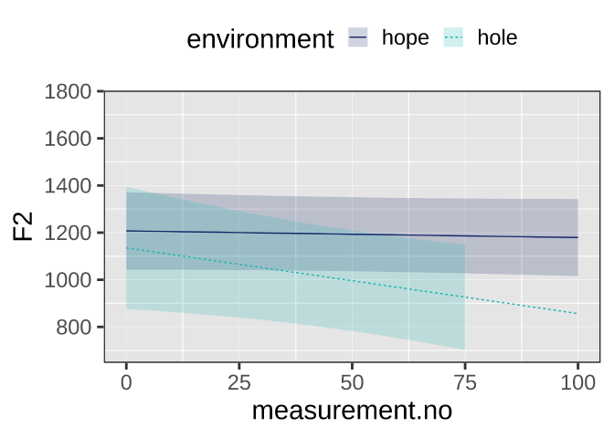
When model plotting goes awry…a thread
#accidental_aRt

Slide 17
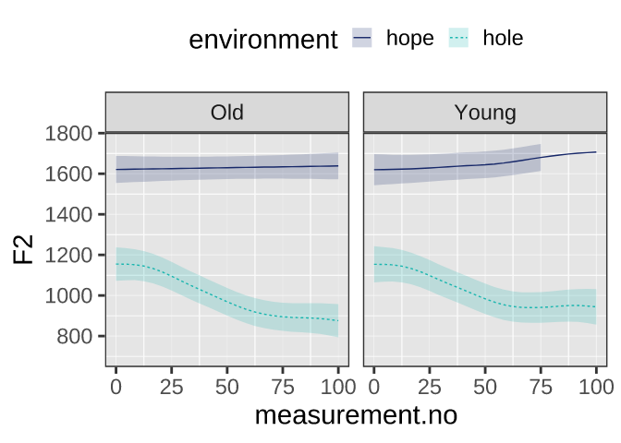
When model plotting goes awry…a thread
#accidental_aRt

